Slide 1
Sales Analyst Position
Objectives:
Evaluate sales performance and identify trends.
Suggest strategies to increase revenue and profitability.

Slide 2
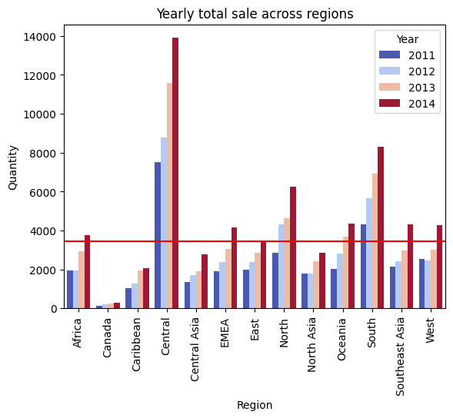
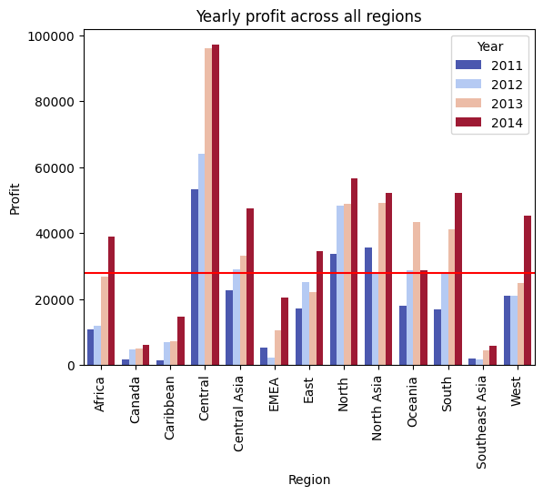
Canada, Caribbean, Central Asia and North Asia are consistently underperforming in sales.
Canada, Caribbean, EMEA and Southeast Asia have consistently generated below average profits.
Sale
Profit

Slide 3
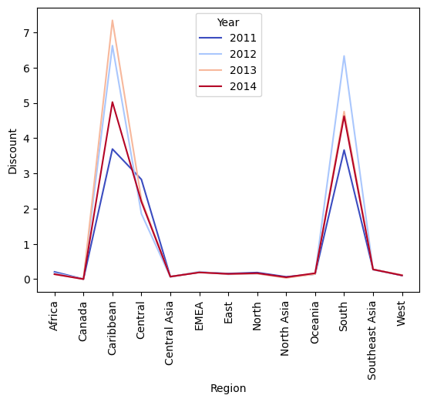
The discount rate is very high in Caribean, Central and South regions

Slide 4
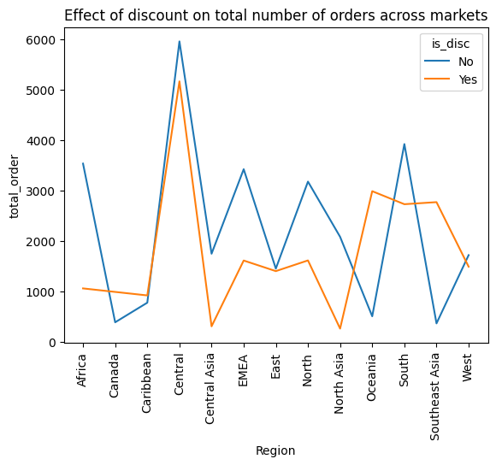
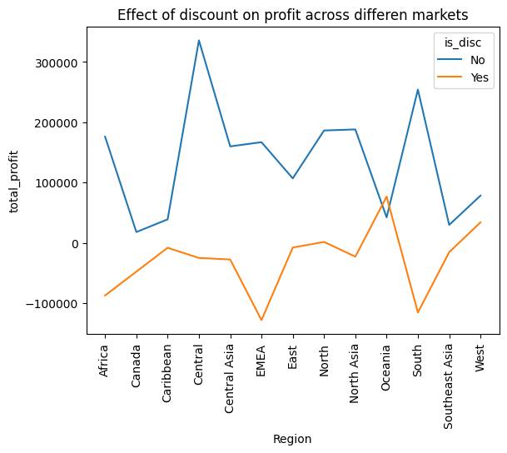
Discount didn’t stimulate product sale in all regions except Oceania and Southeast Asia.
Discount led to a loss in all regions except Oceania.
Sale Profit

Slide 5
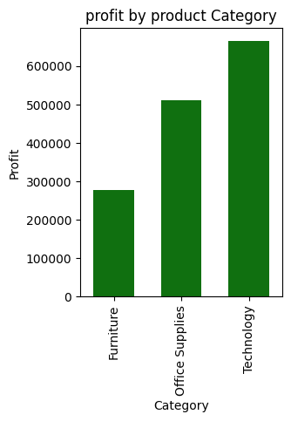
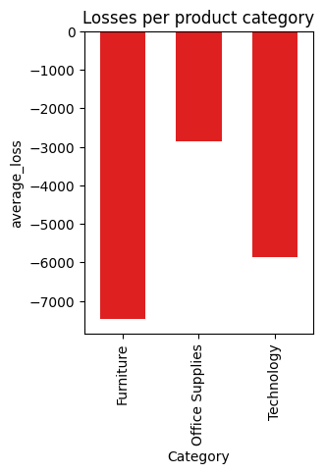
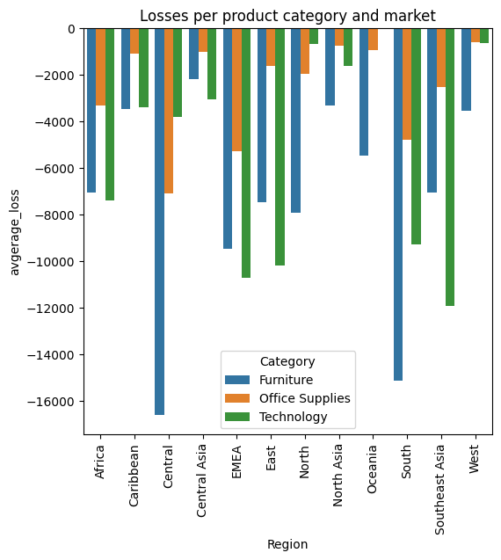
Furniture are the biggest source of loss
The APAC market contributes the biggest

Slide 6
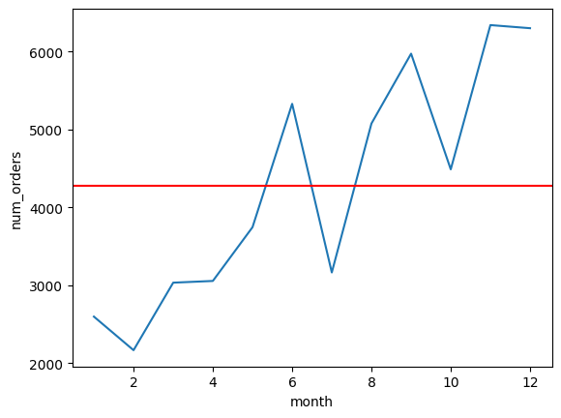
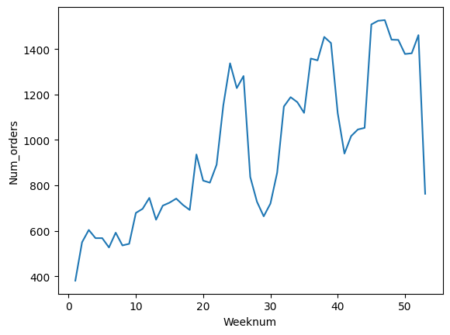
The first five months of the year and July have below average sale activity.
The last two months of the year have the highest sale activity

Slide 7
Market Recommendation
To Maximize Profit
Since the discount did not stimulate sale, it should be reduced or removed.
Oceania seems to be stimulated by the discount. So, provide more discounts to stimulate the purchase of goods.
The discount was not seasonal i.e. the whole year there was a discount.
The specific impact of discount on sale can not be clearly determined.

